Slide 1


USING DEEP LEARNING TO PREDICT OVERALL SURVIVAL TIMES FOR BREAST CANCER FROM H&E-STAINED WHOLE SLIDE BIOPSY IMAGES
By - Anirbit Ghosh 2439281G
Supervisor – Dr. Kevin Bryson

Slide 2
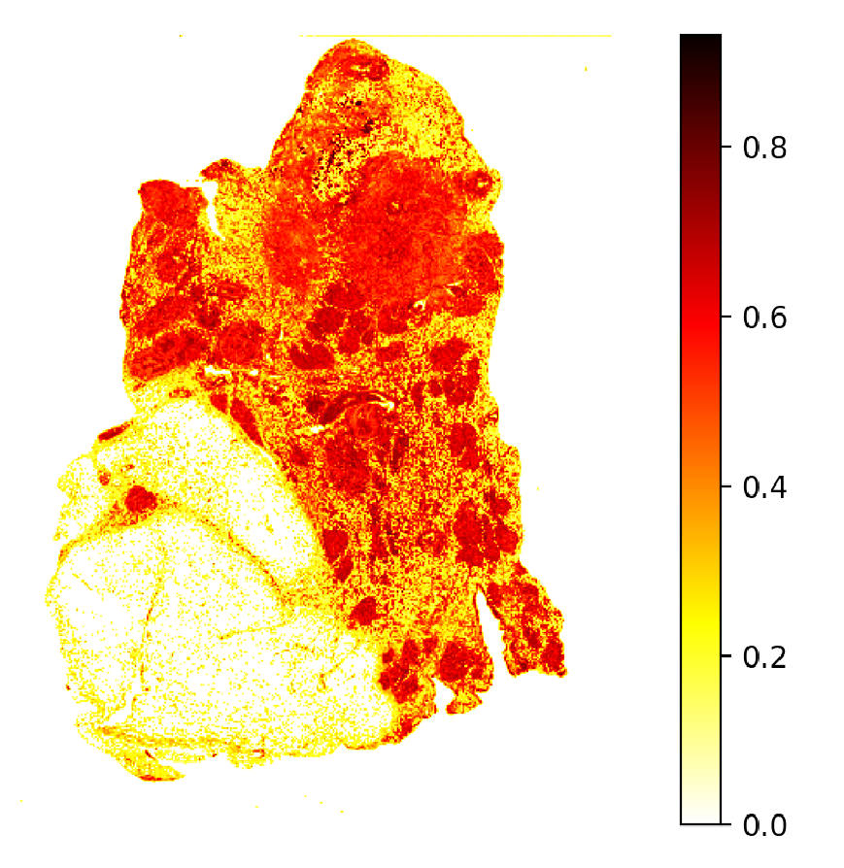
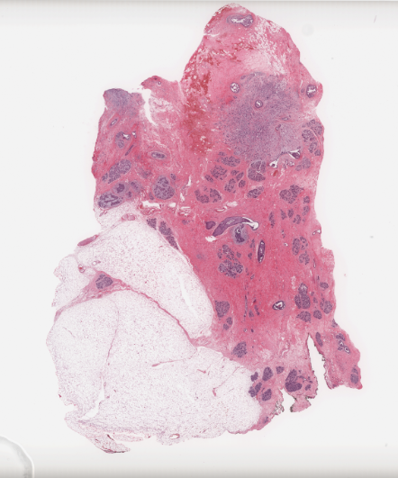
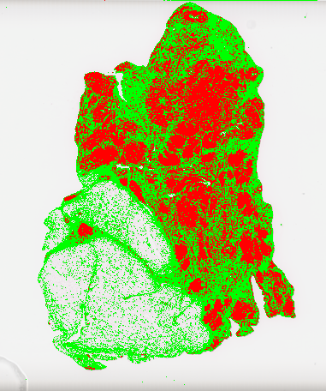
Mean Malignant Intensity
Classification
Regression
Survival Duration (months) | Predicted survival (months)
76.47 | 51.35
Survival Prediction
Malignancy Spread Score
Breast tissue biopsy slide image
Notes:
Generating survival time predictions for patients with breast cancer using their biopsy slide image only.
Go from the raw tissue image to first detect malignant tumours to quantify disease severity and then use that to regress a survival model and make estimations for survival time.

Slide 3
What is the motivation behind doing our project?

Slide 4
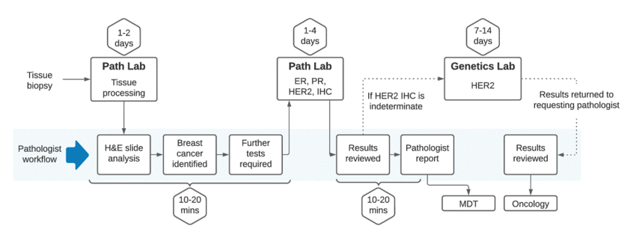
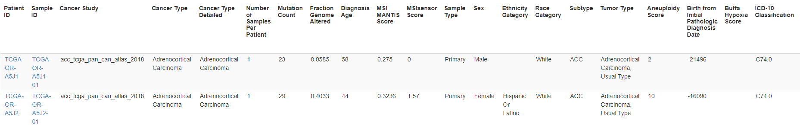

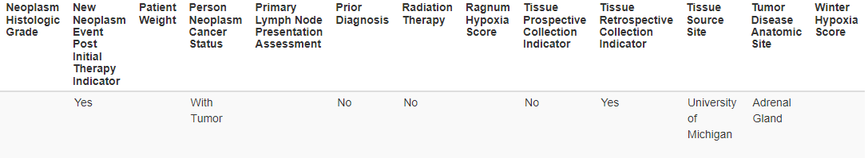
Diagnostic workflow
Clinical data collected for prognosis estimation
Notes:
Tradition diagnostic and prognostic workflow in place
Diagnosis involves biopsy, manual slide analysis, cancer identification which is followed by several tests to get further information on physiological characteristics.
These tests have to be conducted and data processed to generate results.
This data usually looks like this, very vast and some requiring complex tests/processes to obtain.
This has a long time, 30 days from point of biopsy to prognosis delivery.
For cancer, time is very sensitive, so delays like this can worsen situation and maybe take away time from much needed treatment.

Slide 5
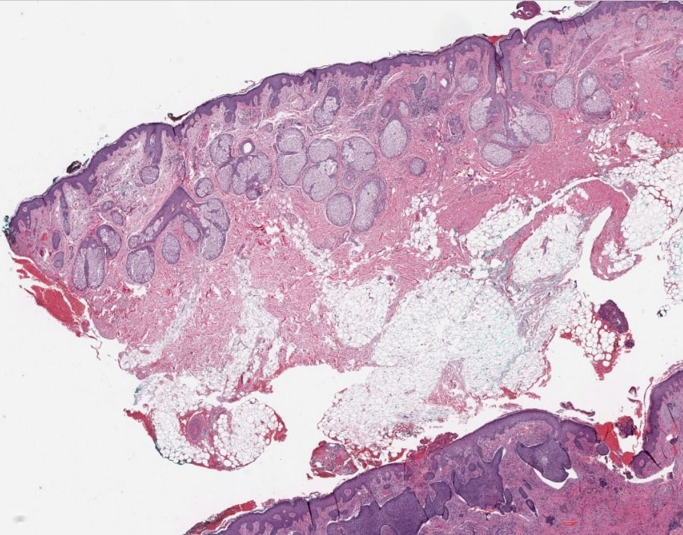
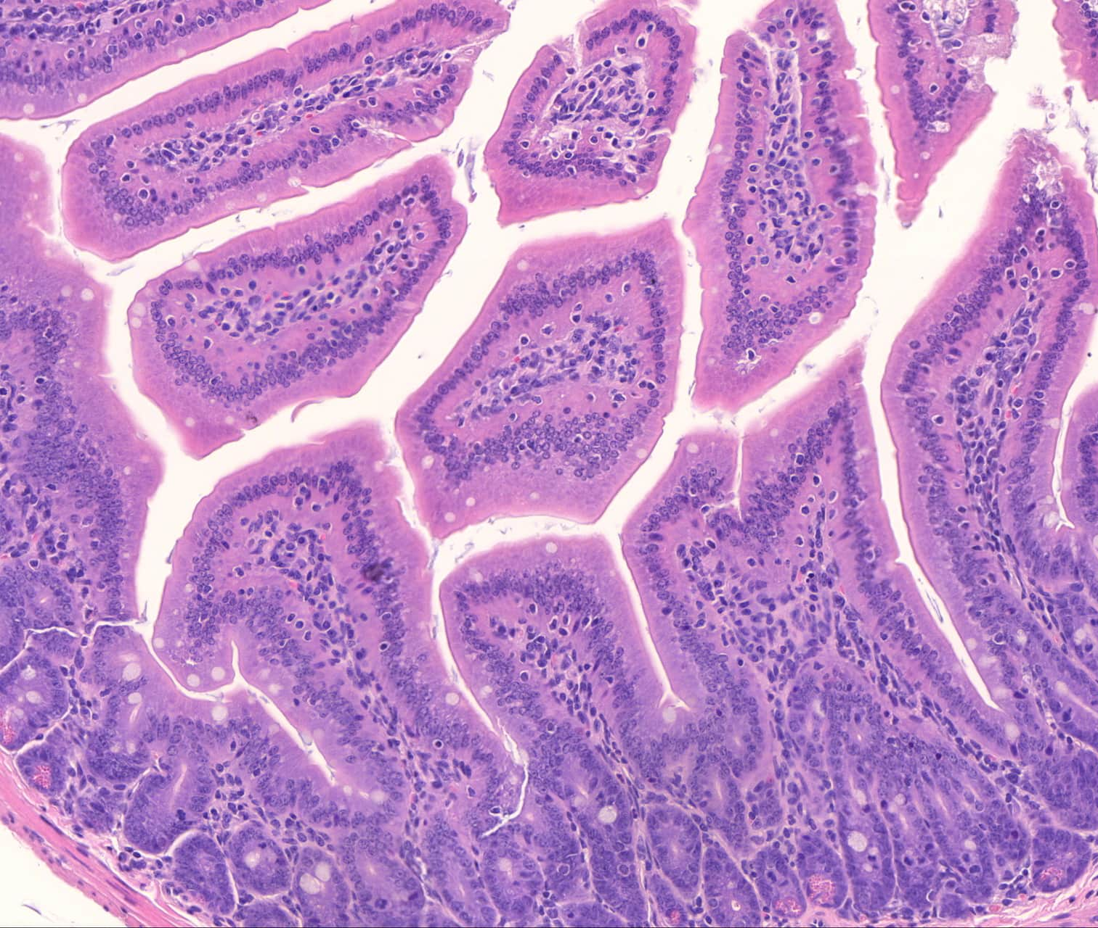
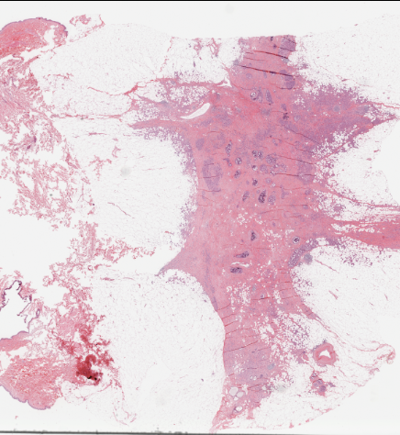
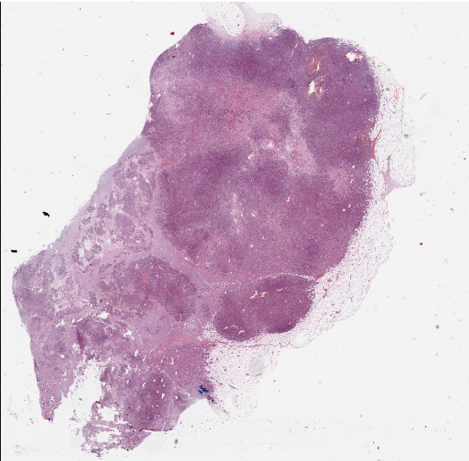
Whole Slide Images of biopsied tissue
Notes:
Investigate viability of using whole slide images in diagnosing and then estimating survival time.
Biopsy contains exact, structural information of the patient’s unique cancer manifestation.
By using biopsy alone if we can minimize the need for additional clinical data then we reduce the delay and likely allow much needed treatment to begin on time
This is not likely to replace current system but supplement it by because diagnosing cancer is a very sensitive process and human intervention will always be needed.

Slide 6
What is The Overall problem We are trying to solve ?

Slide 7
Project aims
Can be broken down into two separate tasks:
Diagnostic stage – Identification of malignant tumor regions from H&E-stained whole slide images of breast tissue.
Prognostic stage – Investigate the viability of whole slide images in estimating overall survival time of patients based on disease severity extracted from their biopsy image.

Slide 8
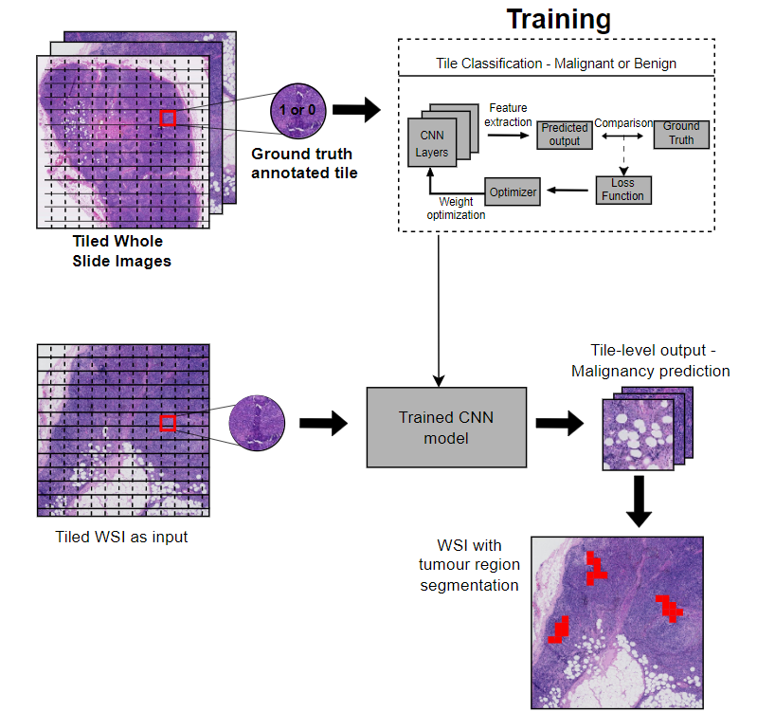
Diagnostic Stage
Notes:
High level process of diagnosing cancer from whole slide Images
2 parts:
Training – using patches of whole slide images, with each patch annotated with the ground truth, train to detect malignant or benign tissue
Using trained model to detect malignancy in a sample dataset and extract some meaningful feature to quantify degree of cancer severity

Slide 9
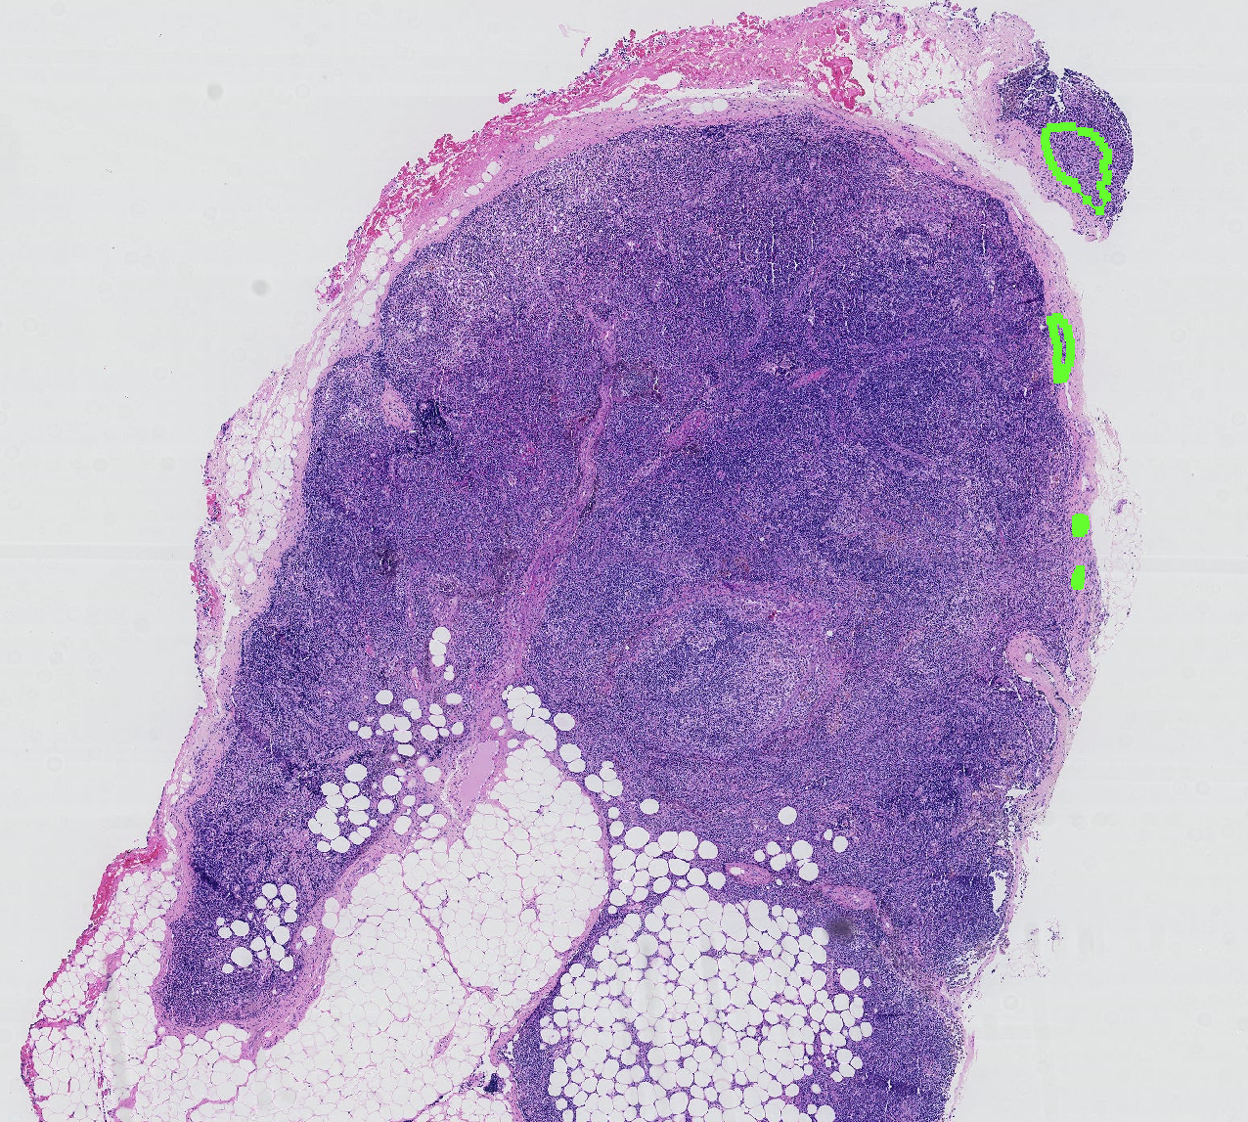
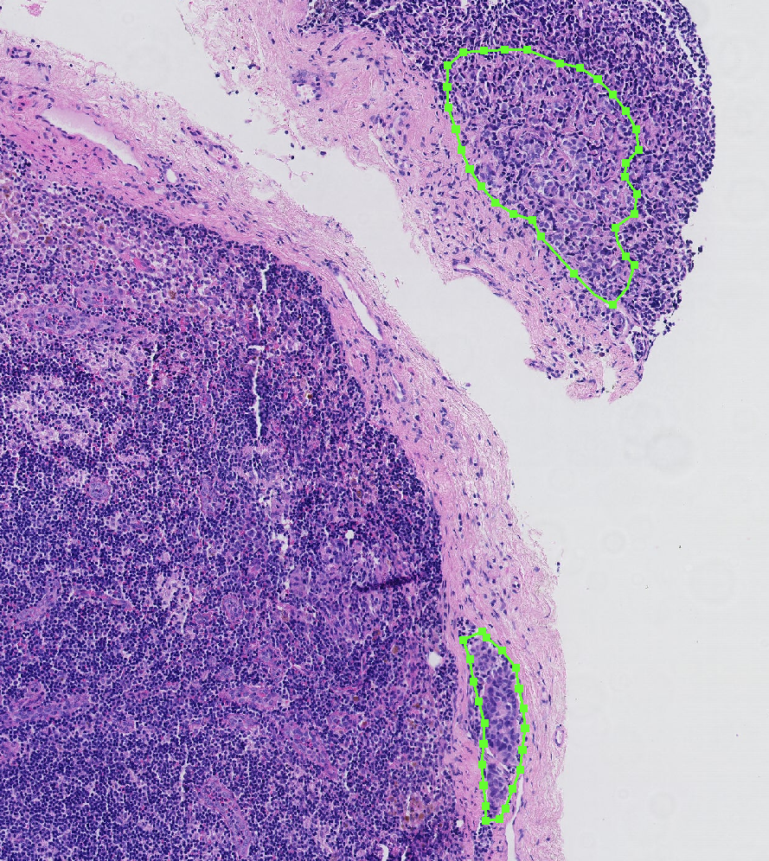
Breast metastases annotated WSI; taken from Camleyon16 dataset.
Core indicators of breast metastases:
Abnormal nuclei growth indicative of regions showing larger Hematoxylin-stained nuclei.
Lower nuclei density and sparse Eosin-stained cytoplasmic regions
Notes:
Core idea behind detecting cancer as an image classification task is :
Malignant areas have very distinct appearance compared to surrounding healthy tissue
It is observed that most malignant areas have a low hematoxylin density, less but large nuclei
Abnormal nuclei growth is indicative of cancer
Second observation is more eosin stain than surrounding tissue
Indicates more sparsely dispersed nuclei, with more cytoplasm visible caused by enlargement of cells, taking more space in the abnormal malignant areas

Slide 10
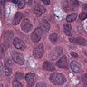
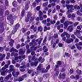
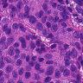
Training Data
Lack of annotated breast cancer data. Infeasible to hire a pathologist and annotate our own dataset.
We used PatchCamelyon (PCAM) dataset – derivative of Camelyon16 challenge data.
Data contains samples of breast metastases in lymph node tissue.
399 WSIs from pathology labs in Netherlands tiled into 96x96 px patches. Each tile is labeled by pathologists with binary annotations (0: benign, 1: malignant)
Balanced training, validation and test sets
We use 100,000 training tiles and 20,000 test and validation tiles
Notes:
We chose a supervised learning approach where we train our model with annotated images
However, very limited data with annotations available publicly
We cannot hire a pathologist to annotate a dataset for us so we have to resort to the only available datset
PCAM dataset – breast metastases found in sentinel lymph node tissue.
WSIs taken from Camelyon16 online challenge data, and split into 96x96px tiles, each annotated as malignant or benign by pathologists to build the PCAM dataset.
Balanced datset, 50-50 split between malignant and benign tiles in each dataset, training, testing and validation.

Slide 11
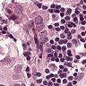
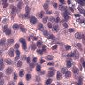
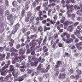
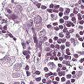
Data Pre-processing
Tiling
Filtering background tiles
Macenko normalization
Augmentation
Un-normalized tiles
Macenko normalized tiles
Notes:
Raw data not suitable for learning or being queried through our model to generate malignancy predictions
Variability in staining, human error, conditions under which tissue was prepared, dye concentration – so normalize using macenko technique
Tiling into 96x96px at 4x magnification to match training images – Data used in feature extraction for survival modeling must be tiled
Background tiles removed to reduce processing space
Agumentation to increase variation of training images, improve learning and reduce overfitting

Slide 12
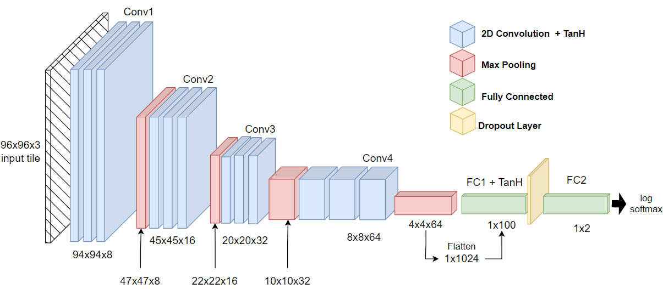
Neural network architecture:
Notes:
Convnet architecture
4 conv layers with max pooling
2 fully connected layers
Hidden layers and first FC layer have tanH activation
Dropout applied at 0.75 to before final layer
Final layer has no activation and output from it is log_softmaxed to get logit probability of each of the two classes.
Adam optimizer with 0.0005 learning rate
LR scheduler with patience 20 epochs and factor 0.5, ReduceLrOnPlateau
negative log likelihood loss

Slide 13
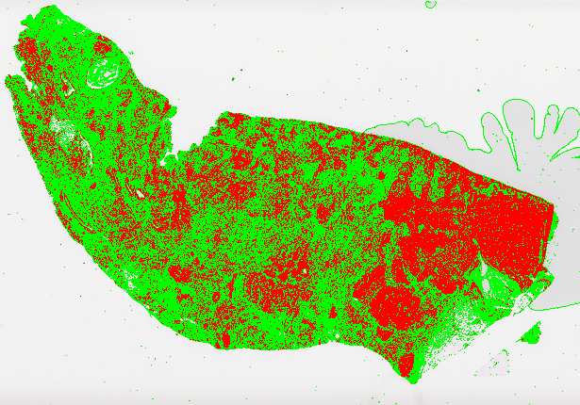
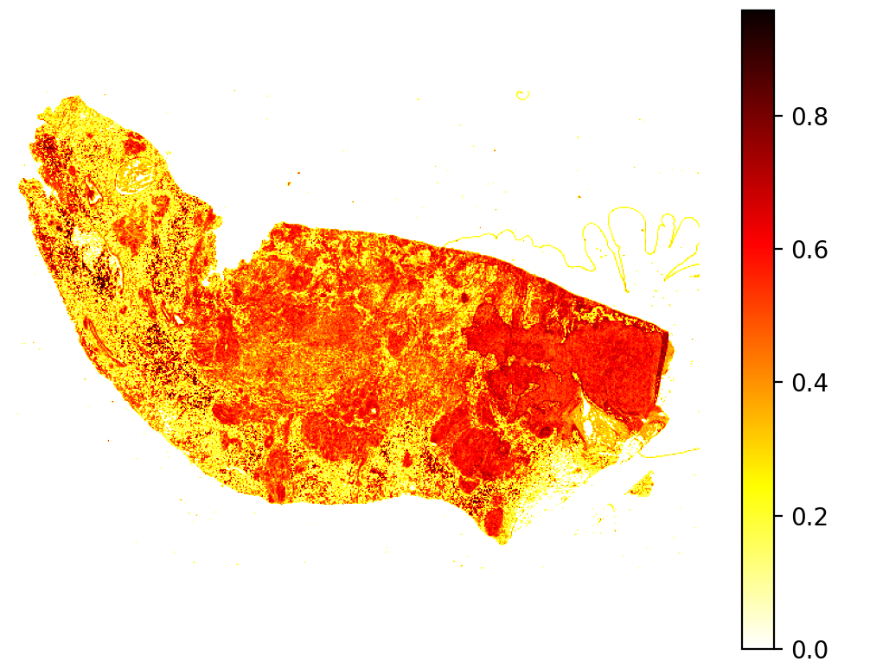
Features extracted from segmented images
1. Malignancy spread score – Discrete binary predictions. Ratio of overall malignant area against total tissue surface area. Higher MSS indicates larger tumor spread and greater disease severity.
2. Mean malignant intensity – Continuous probability predictions. Average probability of malignancy across all tiles of a WSI. Higher MMI indicates more patches of strong malignancy translating to greater disease severity.
Notes:
Single label binary classification
Two forms of output generated:
- Probability of being malignant (between 0 and 1)
This is used to get an exact idea of how confident the prediction of malignancy is, such that areas with high confidence indicate stronger malignancy potential/intensity whereas lower probability indicate areas which are benign/healthy tissue. Allows us to create a covariate feature MMI, the mean malignant probability across all tiles for a given WSI. Higher values indicated overall greater number of strong malignant tiles vs lower value indicates more healthy/weak malignant tiles
Discrete binary class prediction for each tile (0 or 1)
Output whether a tile is malignant or benign. The model’s logits output is thresholded at 0.5 and the class with the higher probability is chosen as the final prediction for each tile.
We extract MSS covariate, which is the ratio of malignant area to the overall tile area of tissue. Gives us an idea of how widespread malignant tumours is relative to the overall size of the tissue.

Slide 14
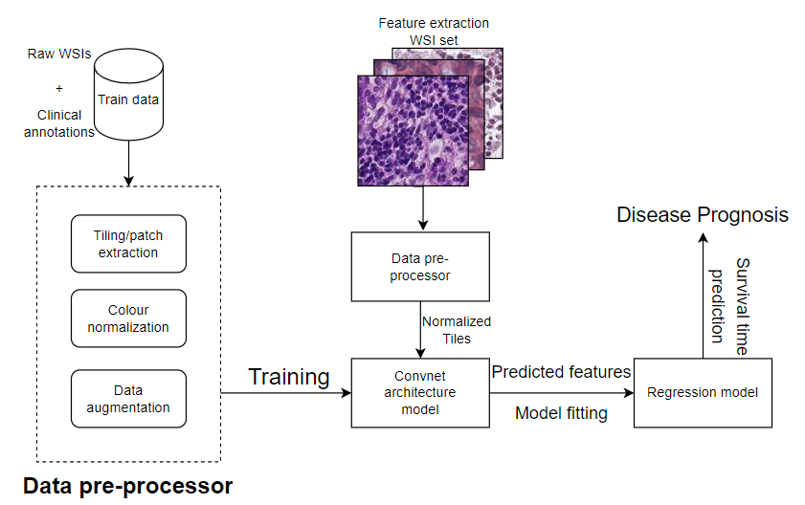
Prognostic Stage

Slide 15
Regression data
Collect breast cancer WSIs of 74 patients from The Cancer Genome Atlas repository
Retrieve each patient’s associated survival duration – time from point of diagnosis to point of death to use as ground-truth in fitting our regression model
Feed each WSI through pre-processor to split them into Maceko normalized tiles of dimension 96x96 px.
Generate metastases predictions for each WSI using our trained model
Calculate MMI and MSS covariate values for each of the 73 WSIs using the tile-level predictions
Combine calculated covariates with the survival duration of each patient to get final regression dataset
Patient id | Survival duration | MMI score | MSS score
TCGA-BH-A1FE | 76.47 | 0.67 | 0.75
Notes:
We curated a dataset of 74 breast cancer WSIs from TCGA
Gathered their associated survival duration recorded in clinical data
Passed each image through our trained CNN to generate malignancy segmentation and calculate both covariates for each slide image
These calculated values along with associated survival time as ground truth will be used in fitting a regression model to predict survival times when given a certain covariate value.

Slide 16
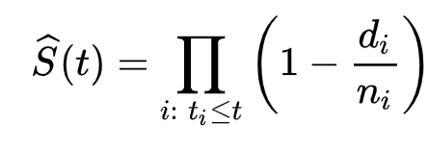
Cox proportional hazards model
Kaplan-meieR method
λ(t|x) = λ₀(t) exp(β_{i}x_{i})
S(t) is the survival function
t is the given time at which we want to estimate survival probability
For each time t_{i} we calculate the ratio between the number of deaths that take place (d_{i}) and the number of subjects that survive at each time (n_{i}).
Non-parametric statistical model
Gives us the probability of survival past time t.
Hazard Ratio exp(β_{i}x_{i}) from Cox model gives the probability of death at each point of time t_{i}
λ(t|x) is the hazard function
t represents time.
x_{i} denotes a vector for each covariate we use for our model.
β is the regression coefficient vector calculated for our model.
λ₀ is the baseline hazard under initial conditions x = 0
Semi-parametric, linear regression model
Gives us a hazard function that represents the hazard
Notes:
To build our survival model, we have first implemented a semi-parametric linear regression model called Cox prop hazard model. It allows us to model how a specified factor or covariate influence the disease hazard or the rate of death at a particular point in time.
As we are investigating the viability of WSIs in making survival predictions, we fit univariate Cox models where the only factor is the feature extracted from the whole slide image. We fit a univariate model for each covariate calculated.
However, Cox model cannot generate survival time predictions as it represents the probability associated with the risk of death at a given point in time. Useful in analyzing the change in risk of death with change in covariate level. But to measure survival duration, we essentially find the length of time until hazard/risk of death reaches a 100%. A cox model cannot do this as the hazard remain constant until the associated covariate changes.
So we use a non-parametric model, the Kaplan meier estimator, to get the probability of survival past a given time t. The right hand side essentially calculates the product of survival probability for all points of time upto t. The di/ni component represents ratio of deaths to survivors at given time which we can replace with our hazard ratio obtained from the Cox model as it represents population-level probability of deaths.
Using the survival function we can predict a median survival time based on the hazard generated by a given covariate value. This effectively models the effect of a given covariate on patient survival in terms of the disease hazard it creates.

Slide 17
Results

Slide 18
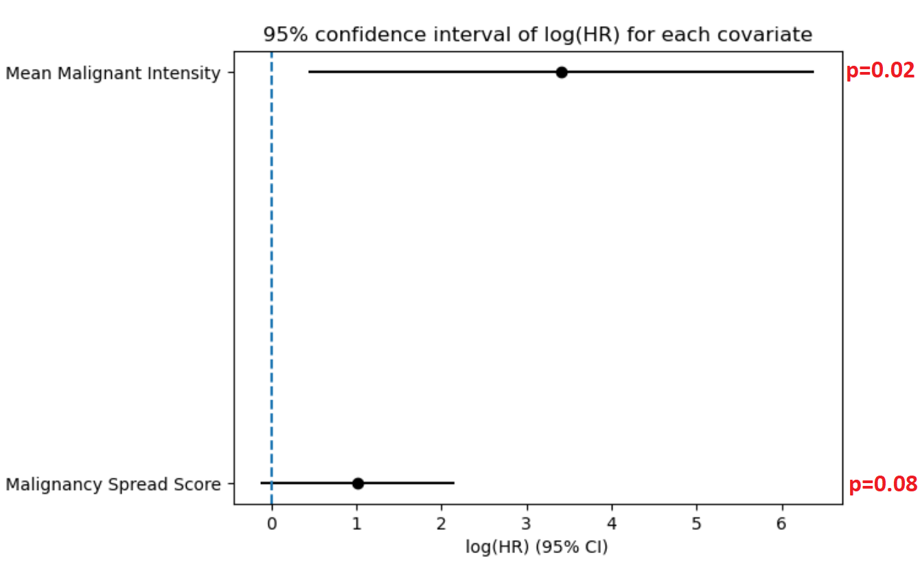
Survival Model fit
Covariate | Exp(β) | z | p
MSS | 2.78 | 1.76 | 0.08
MMI | 30.20 | 2.25 | 0.02
95% Confidence intervals of each model
MMI showed much larger confidence interval indicating more uncertainty in estimating the associated HR but shows statistical significance as null value of HR = 1 is not in the interval
MSS has a shorter interval indicating greater precision in HR estimation but does not show significance as it fails to reject the null value.
The HR value of both models is > 0 indicating both covariates are risk factors negatively effecting survival.
HR of MMI is much higher than MSS implying the severity captured by that covariate has a much stronger correlation with disease hazard.
MMI had a higher z-value than MSS indicating its β coefficient is more statistically different from 0 and has a stronger effect on patient survival.
In survival modeling p<=0.05 is considered significnat
Only the model fitted using MMI covariate showed statistically significant effect on patient survival (p=0.02).

Slide 19
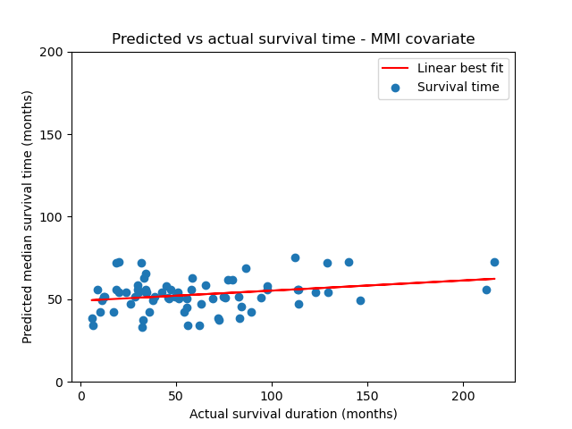
Survival time prediction evaluation
5-fold cross validation results:
Covariate | Mean RMSE (months) | +/- Std deviation (months)
MMI | 47.08 | 29.02
MSS | 47.13 | 29.00
Likely reasons for poor performance:
Left censored data
Patients’ treatment regime is not known
Access to healthcare - affordability and insurance access
Smoking status, immune system health, underlying medical conditions, age etc.
Notes:
5 fold validation – high errors, at best upto 18 months within real time
Plot prediction vs real survival duration
Does not show linear correlation, most predictions between 30-80 months
Doesn’t scale very well for higher survival times
Similarly lower than <30 is not predicted correctly
Reasons:
Data left censored, no idea how much delay until disease diagnosed, can effectively reduce survival time as disease progression, less treatment options etc
This raises the true hazard associated with the patient’s case and since our model is univariate, the amplified risk cannot be accounted for by the physical extent of malignancy as an indicator of disease severity alone
Similarly, protective effects by treatment received after diagnosis is not accounted for by our model which in turn is subject to regional variability based on healthcare affordability, access to health insurance and so on
They have the effect of reducing effective disease hazard that our univariate model fails to account for causing predictions to be over estimated.
However, accounts for general survival trend accurately, indicates higher time for higher samples and vice versa.
Indicates our covariates from WSIs do have some influence on patient survival, although that influence is incomplete, it can still characterize general survival trend for a given sample

Slide 20
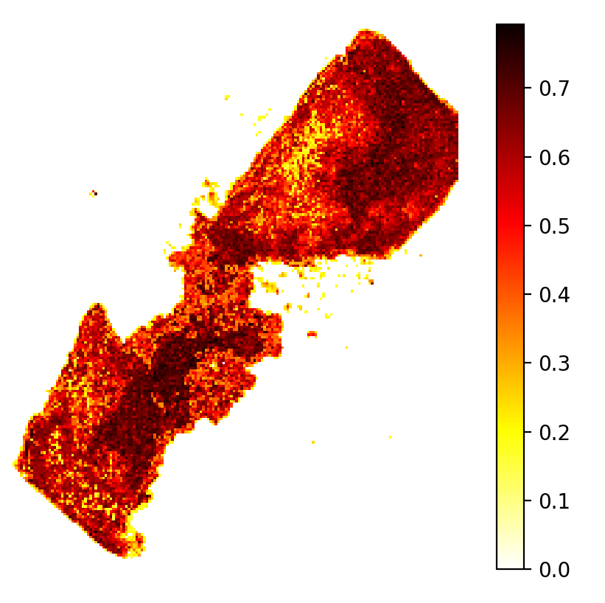
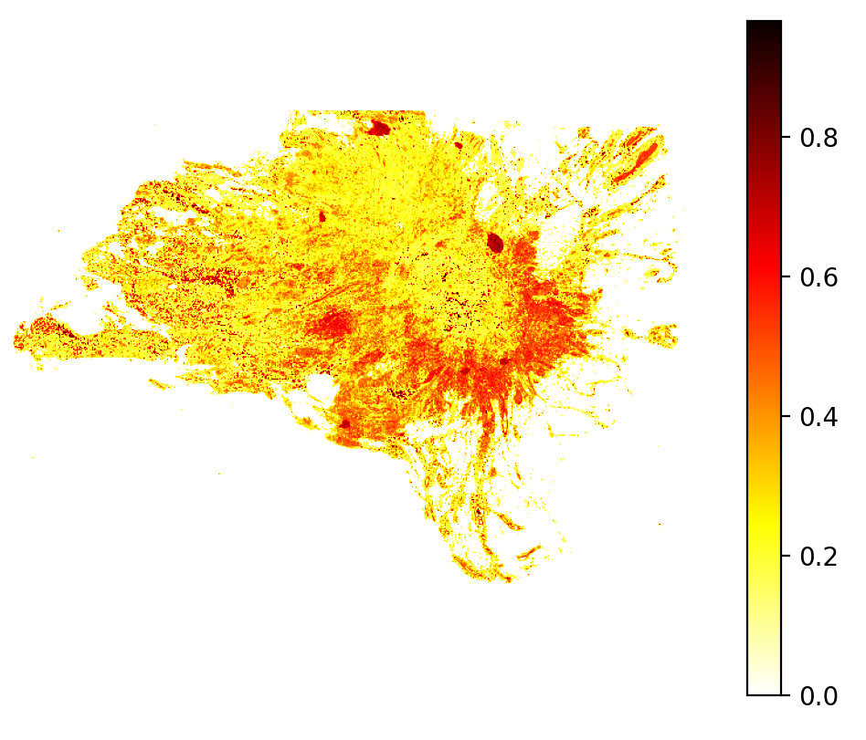
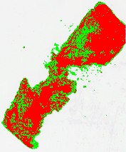
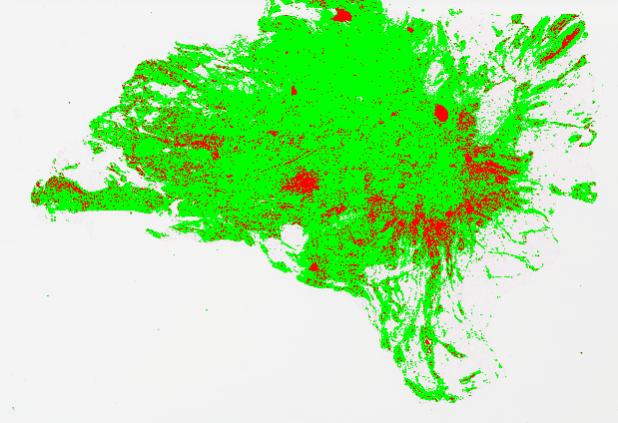
Breast cancer detection performance – qualitative evaluation
Recorded survival duration: 6.47 months
Recorded survival duration: 128.98 months
Notes:
Quantitatively evaluating diagnostic stage was not possible
We internally validated on PCAM validation data giving 70% accuracy, but it is lymph node samples so we cant tell if it works equally well on breast tissue
No annotated breast samples available online on TCGA, so cannot evaluate model success in detecting metastases without pathologist verification
Only qualitative validation is possible.
We observed our covariate can characterize general survival trends of samples, this is further validated by observing predictions qualitatively
More severe cases have a lower ground truth survival time compared to less severe predictions
Thus, if our model was completely failing on breast tissue due to being trained on lymph node, this trend would not be observed.
Our model is successful at detecting metastases to a degree, proving learning can be transferred from lymph node to breast tissue likely because the actual metastatic cells retain the same characteristics irrespective of
Where they metastasize to. The structure of cancer cells is distinct from healthy surrounding cells, so our model can learn how to identify breast malignant cells and carry over that learning to other tissue types.

Slide 21
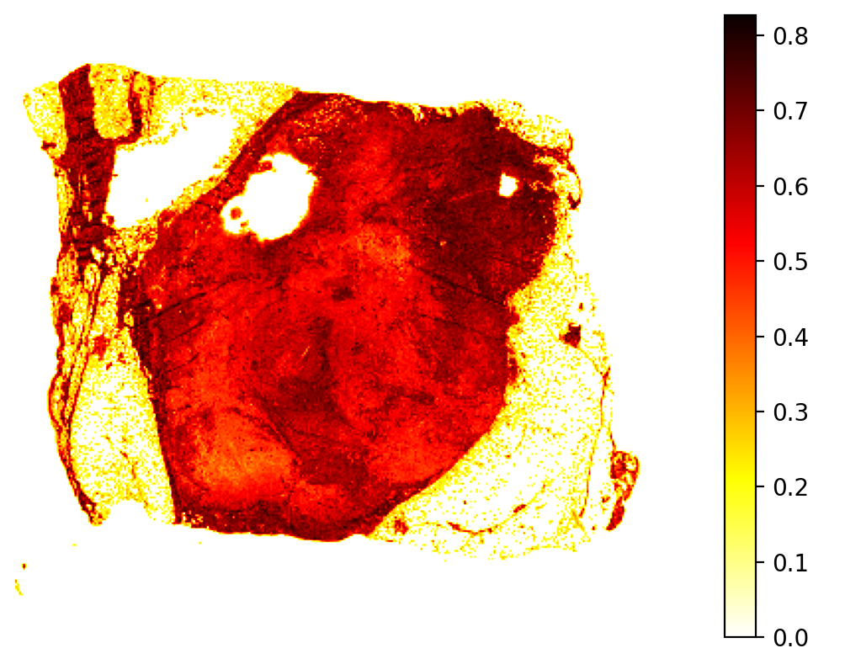
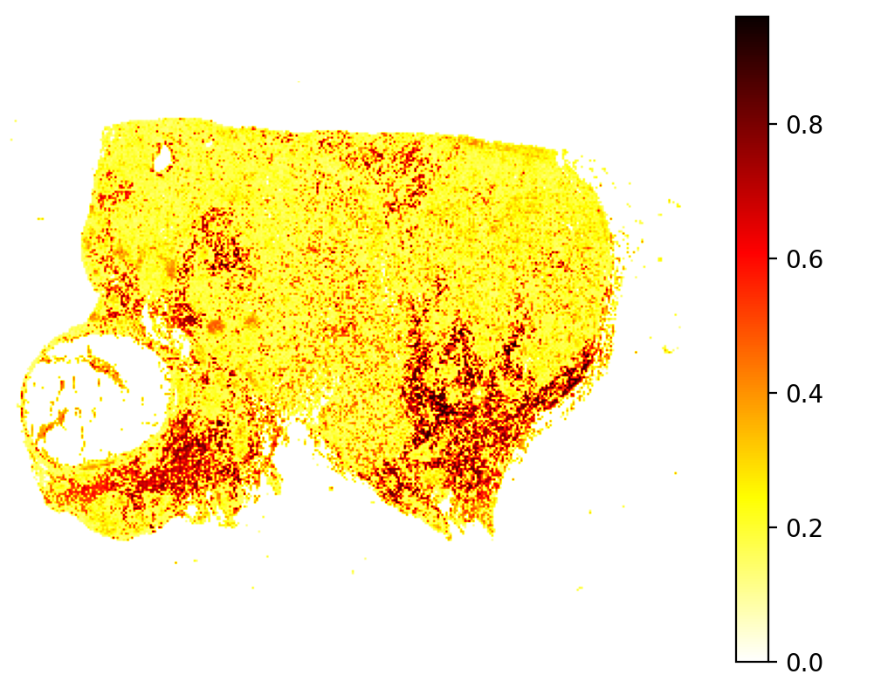
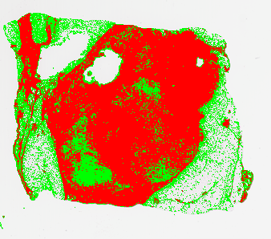
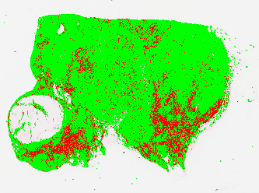
Recorded survival time: 17.21 months
Recorded survival time: 216.59 months
Notes:
Heres another example showing a similar trend. This shows that our diagnostic predictions were not totally random as they consistently exhibited a logical correlation to patient survival time indicating that our model has learnt to meaningfully capture malignant severity to a reasonable extent. This indicates that our diagnostic model despite being trained on lymph node tissue is able to effectively detect breast metastases in breast tissue.

Slide 22
Conclusion

Slide 23
Diagnostic stage:
Internal validation on PCAM data showed up 70% accuracy in malignancy classification.
We qualitatively showed that the predicted metastases matches the corresponding survival duration recorded for each sample. High severity predictions correspond to low survival and vice versa.
Learning of breast metastases acquired from lymph node tissue can be transferred to identify metastases in breast tissue to a reasonable degree.
Future work: Can be improved using contextually appropriate data to train the model. An extension could be using weakly supervised learning instead of supervised learning approach to avoid needing annotated data.
Prognostic stage:
Correlation between image-based features and patient survival was not strong enough to viably use WSIs in exact prognosis estimation without additional clinical data.
This is because patient survival is influenced by several external factors, which univariate hazard models cannot characterize accurately.
It can, however, predict the general trend in survival based on metastases severity which can provide a rough, initial baseline to allow prioritizing high-risk cases for treatment.
Future work: Use multivariate models to extend hazard functions to be more realistic or use a different survival model like Aalen’s additive hazards regression to model dynamic hazard using covariates that change with time.

Slide 24
Thank you
Project source code: https://github.com/AnirbitGhosh/L4-Project

